Slide 1
Introduction to Computational Thermodynamics
Section 3.1
Pressure and Volume Solvers

Slide 2
Introduction
In Part 2 you saw a broad overview of the different equations of state (EoS) available
Part 3 will show how to use an EoS to obtain less-obvious properties of interest
Section 3.1 discusses solving an equation of state for the volume

Slide 3
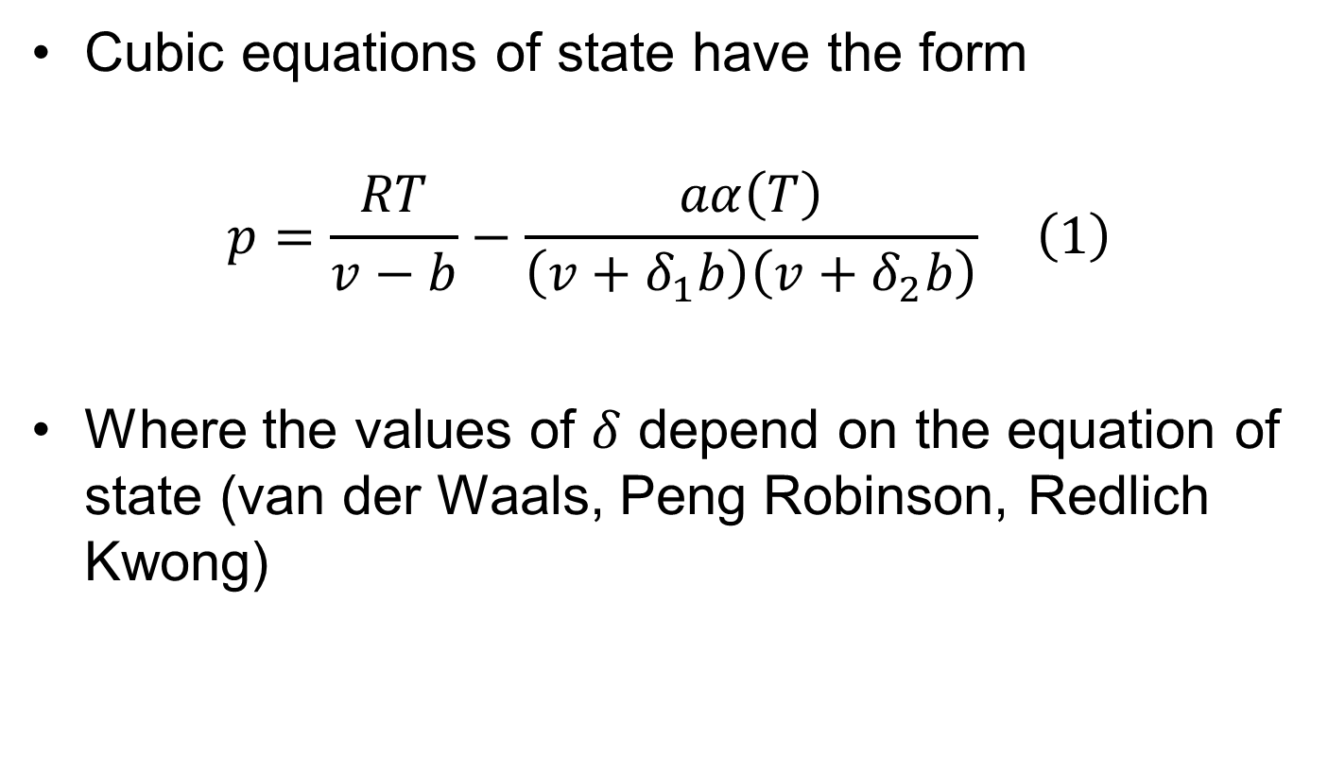
Cubic EoS
Cubic equations of state have the form
$$p=\frac{RT}{v−b}−\frac{aα\left(T\right)}{\left(v+δ_{1}b\right)\left(v+δ_{2}b\right)} \left(1\right)$$
Where the values of $δ$ depend on the equation of state (van der Waals, Peng Robinson, Redlich Kwong)

Slide 4
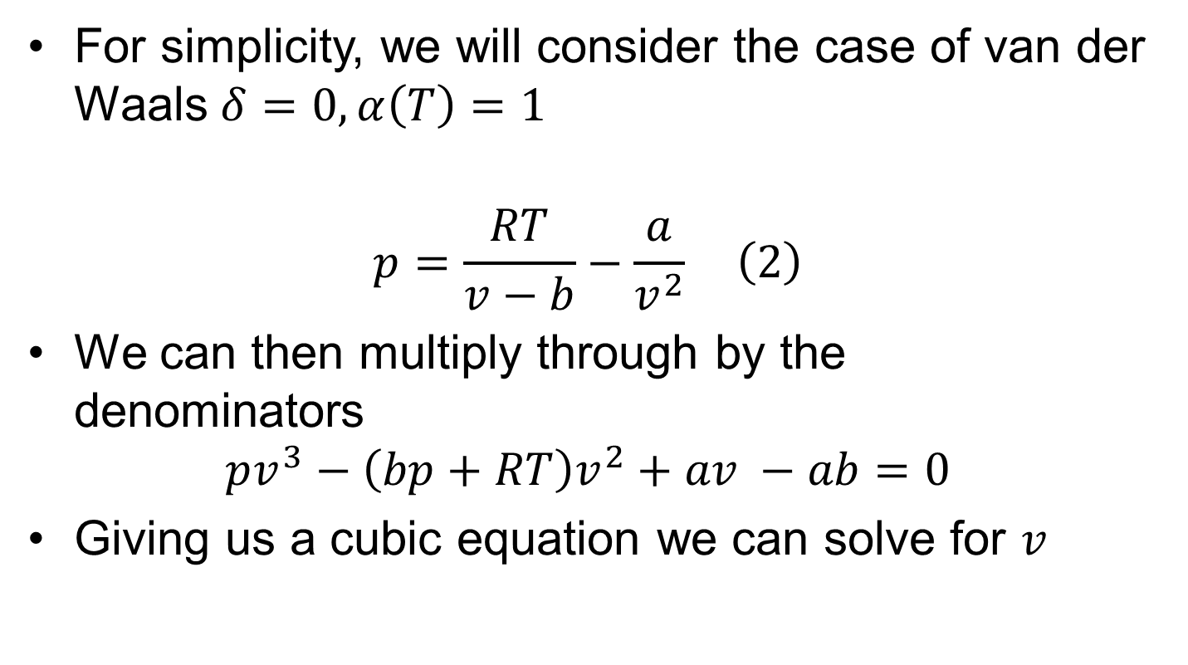
Cubic EoS
For simplicity, we will consider the case of van der Waals $δ=0, α\left(T\right)=1$
$$p=\frac{RT}{v−b}−\frac{a}{v^{2}} \left(2\right)$$
We can then multiply through by the denominators
$$pv^{3}−\left(bp+RT\right)v^{2}+av −ab=0$$
Giving us a cubic equation we can solve for $v$

Slide 5
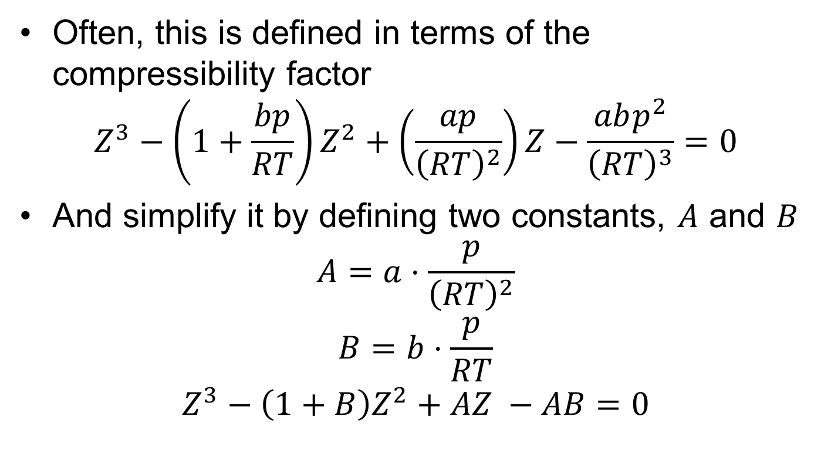
Cubic EoS
Often, this is defined in terms of the compressibility factor
$$Z^{3}−\left(1+\frac{bp}{RT}\right)Z^{2}+\left(\frac{ap}{{\left(RT\right)}^{2}}\right)Z−\frac{abp^{2}}{{\left(RT\right)}^{3}}=0$$
And simplify it by defining two constants, $A$ and $B$
$$A=a⋅\frac{p}{{\left(RT\right)}^{2}}$$
$$B=b⋅\frac{p}{RT}$$
$$Z^{3}−\left(1+B\right)Z^{2}+AZ −AB=0$$

Slide 6
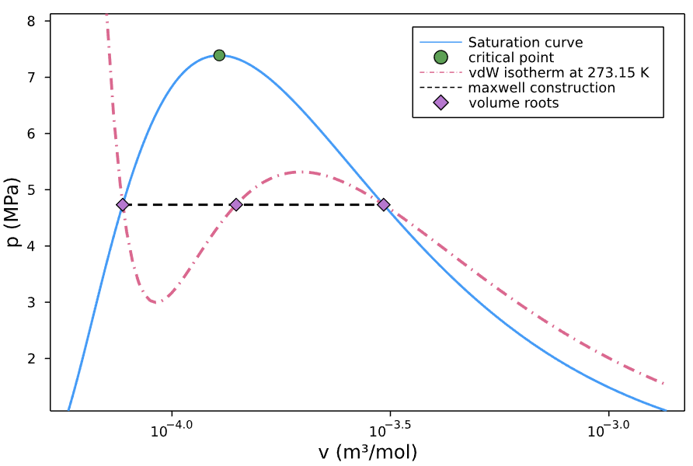
Cubic EoS

Slide 7
Cubic EoS
All cubic equations are analytically solvable
This allows us to cheaply evaluate all volume roots
When more than one real root is present, the chemical potentials are evaluated and the most stable phase is chosen

Slide 8
Cubic EoS
Show implementation in notebook

Slide 9
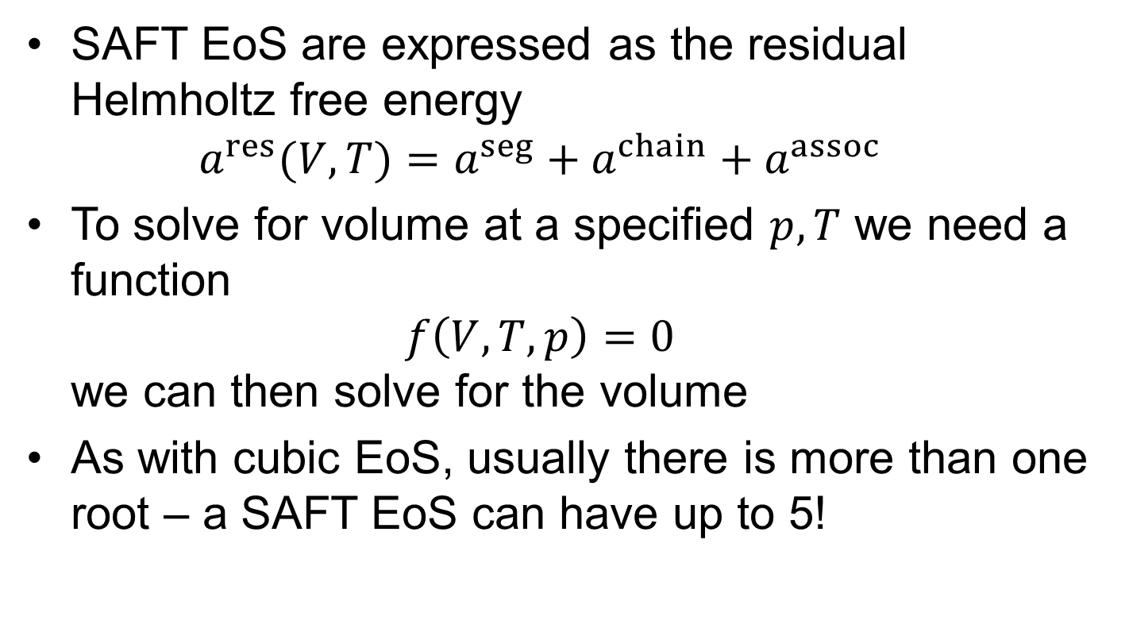
SAFT EoS
SAFT EoS are expressed as the residual Helmholtz free energy $a^{res}(V, T)=a^{seg}+a^{chain}+a^{assoc}$
To solve for volume at a specified $p, T$ we need a function $f\left(V, T,p\right)=0$ we can then solve for the volume
As with cubic EoS, usually there is more than one root – a SAFT EoS can have up to 5!

Slide 10
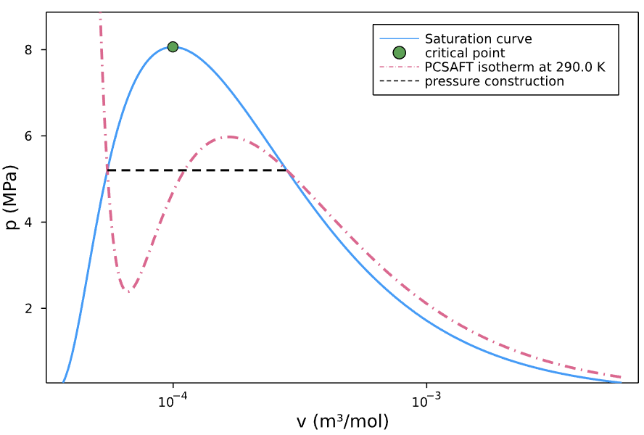
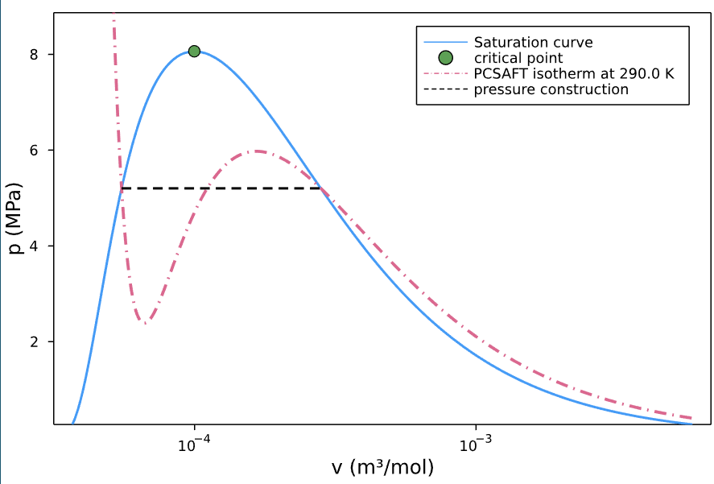
SAFT EoS
Typical case for PCSAFT:

Slide 11
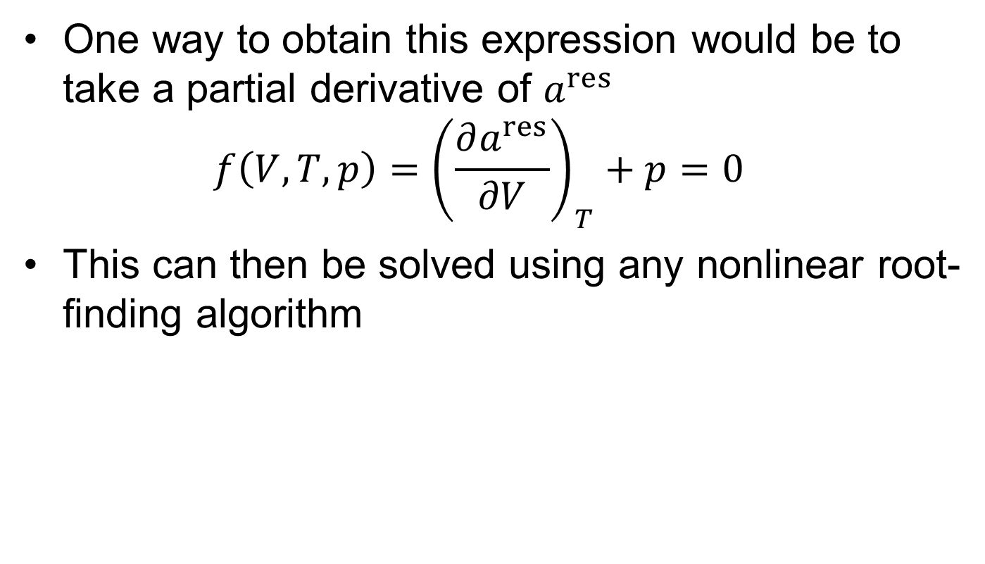
SAFT EoS
One way to obtain this expression would be to take a partial derivative of $a^{res}$ $f\left(V,T,p\right)={\left(\frac{∂a^{res}}{∂V}\right)}_{T}+p=0$
This can then be solved using any nonlinear root-finding algorithm

Slide 12
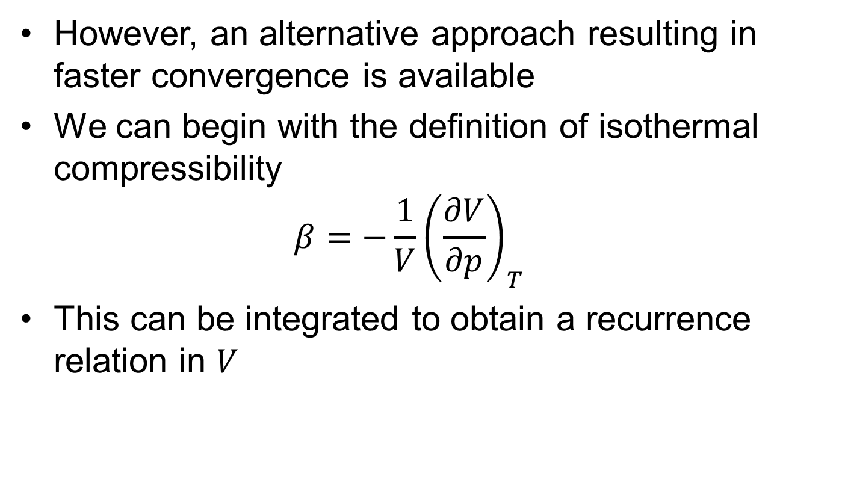
SAFT EoS
However, an alternative approach resulting in faster convergence is available
We can begin with the definition of isothermal compressibility $β=−\frac{1}{V}{\left(\frac{∂V}{∂p}\right)}_{T}$
This can be integrated to obtain a recurrence relation in $V$

Slide 13
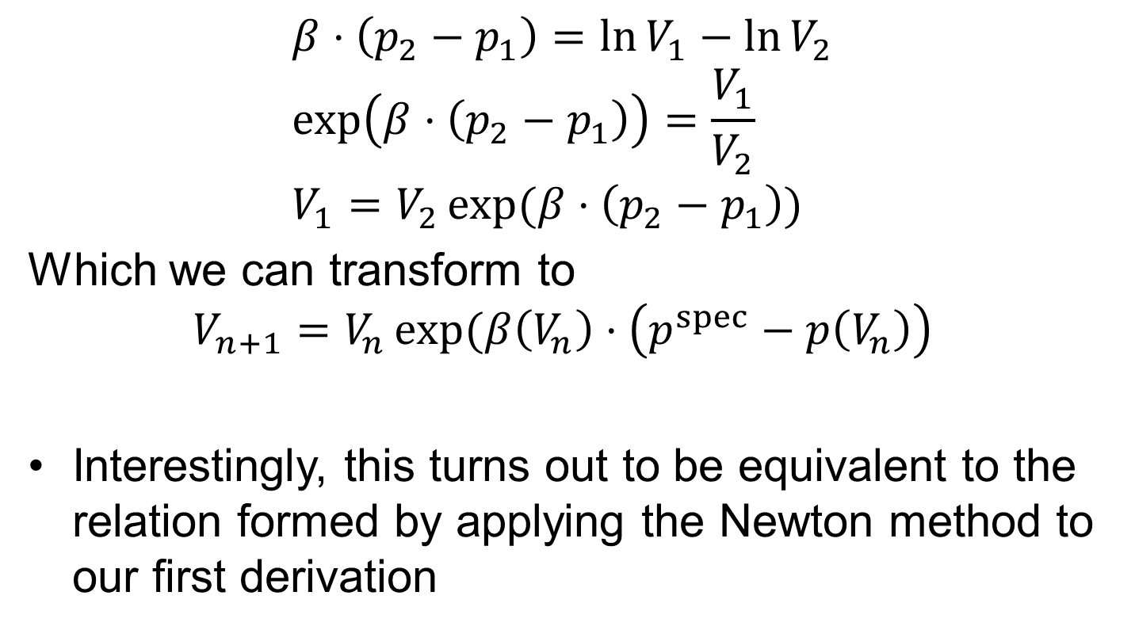
SAFT EoS
$$β⋅\left(p_{2}−p_{1}\right)=\ln{V_{1}}−\ln{V_{2}} \\ \exp\left(β⋅\left(p_{2}−p_{1}\right)\right)=\frac{V_{1}}{V_{2}} \\ V_{1}=V_{2}\exp{(β⋅\left(p_{2}−p_{1}\right))}$$
Which we can transform to
$$V_{n+1}=V_{n}\exp{(β\left(V_{n}\right)⋅\left(p^{spec}−p\left(V_{n}\right)\right)}$$
Interestingly, this turns out to be equivalent to the relation formed by applying the Newton method to our first derivation

Slide 14
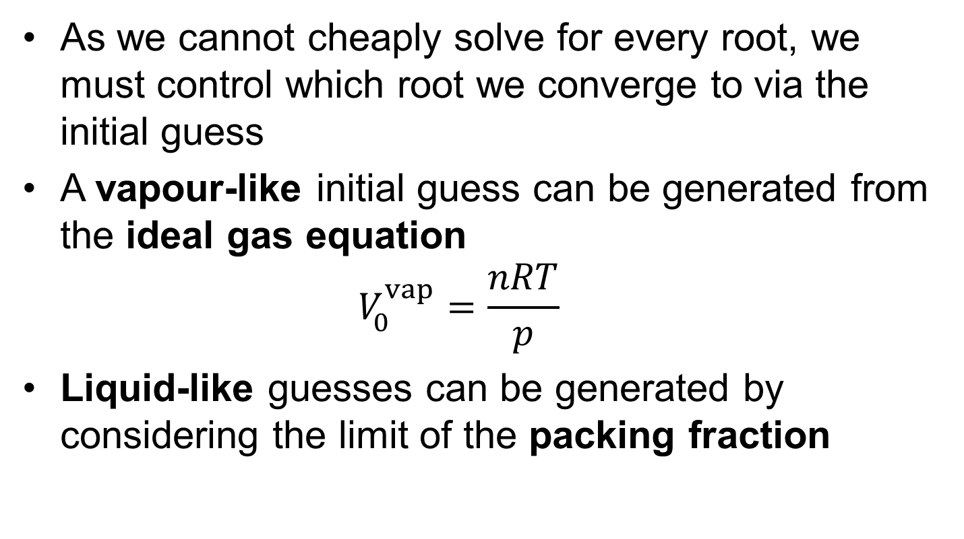
Initial Guesses
As we cannot cheaply solve for every root, we must control which root we converge to via the initial guess
A vapour-like initial guess can be generated from the ideal gas equation $V_{0}^{vap}=\frac{nRT}{p}$
Liquid-like guesses can be generated by considering the limit of the packing fraction

Slide 15


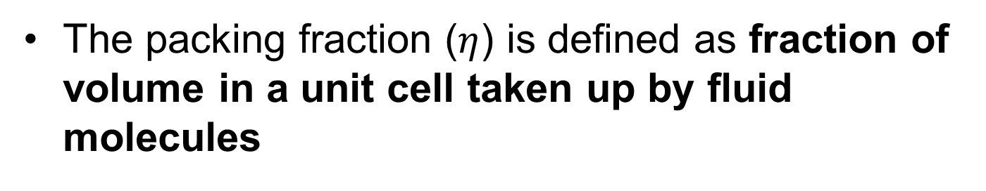






Initial Guesses
The packing fraction ($η$) is defined as fraction of volume in a unit cell taken up by fluid molecules
$$σ$$
$$σ$$
$$σ$$
$$σ$$
$$η→1$$
$$σ$$
$$σ$$
$$σ$$
$$σ$$
$$σ$$
An unphysical lower-bound
$$σ$$
$$σ$$
$$σ$$

Slide 16
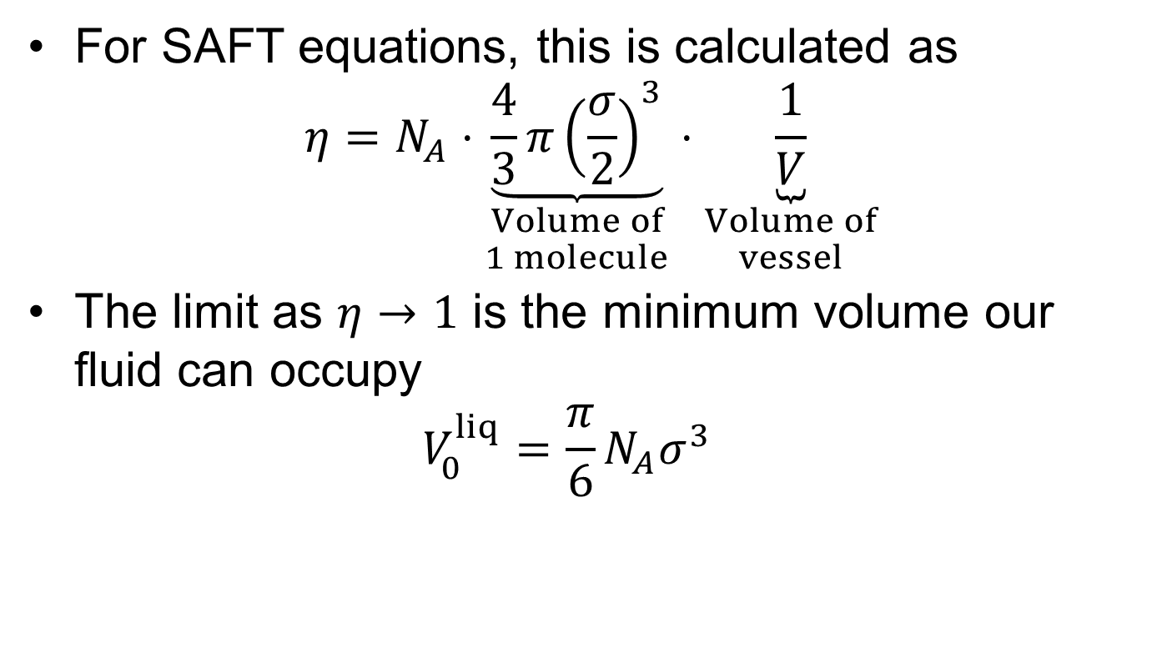
Initial Guesses
For SAFT equations, this is calculated as $η=N_{A}⋅\underset{\begin{aligned}Volume of \\ 1 molecule\end{aligned}}{\underbrace{\frac{4}{3}π{\left(\frac{σ}{2}\right)}^{3}}}⋅\underset{\begin{aligned}Volume of \\ vessel\end{aligned}}{\underbrace{\frac{1}{V}}}$
The limit as $η→1$ is the minimum volume our fluid can occupy $V_{0}^{liq}=\frac{π}{6}N_{A}σ^{3}$

Slide 17
Implementation
Switch to notebook to show implementation

Slide 18
Key messages
The primary advantage of cubic EoS is how cheap they are to solve for the volume at a given pT
SAFT EoS must be solved numerically
The root converged to for SAFT EoS is controlled through the initial guess
Generally, both liquid and vapour roots should be converged to determine which is more stable

Slide 19
Convergence
Typically this method converges quickly and reliably

